Slide 1
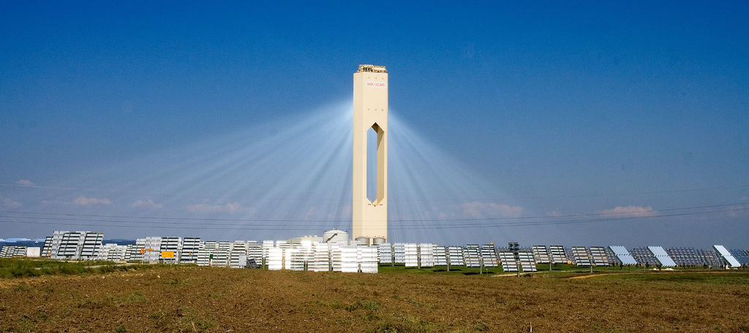
Tutorial 14. ENERGY INVESTMENT OBJECTS
Part 3. Renewable or non-traditional energy sources
INVESTMENT DESIGN INNOVATION IN
THE ENERGY SYSTEM
A solar collector is a device for collecting the thermal energy of the Sun, carried by visible light and near-infrared radiation. Unlike solar cells, which produce electricity directly, the solar collector heats the material-the heat carrier.
Flat Solar Collector
A flat collector consists of an element that absorbs solar radiation, a transparent coating and a thermal insulation layer, and a coolant flow circuit (a copper coil). The absorbing element is called an absorber (a sheet of copper due to its high thermal conductivity); it is connected to a heat-conducting system. The transparent element (glass) is usually made of tempered glass with a reduced metal content. In the absence of heat analysis (stagnation), flat collectors are able to heat water up to 190-200 °C.
To increase the efficiency, special optical coatings of the outer coating are used, which do not emit heat in the infrared spectrum.
Vacuum Solar Collector
It is possible to increase the temperature of the coolant up to 250-300 °C in the mode of limiting heat extraction. This can be achieved by reducing heat losses due to the use of a multi-layer glass coating, sealing or creating a vacuum in the collectors. The solar heat pipe has a device similar to household thermos flasks.

Slide 2
Tutorial 14. ENERGY INVESTMENT OBJECTS
Part 3. Renewable or non-traditional energy sources
INVESTMENT DESIGN INNOVATION IN
THE ENERGY SYSTEM
Only the outer part of the tube is transparent, and the inner tube is coated with a highly selective coating that captures solar energy between the outer and inner glass tube there is a vacuum. It is the vacuum layer that makes it possible to save about 95% of the captured thermal energy.
In addition, heat pipes that act as a heat conductor have been used in vacuum solar collectors. When the installation is exposed to sunlight, the liquid located in the lower part of the tube, heating up, turns into steam. The vapors rise to the upper part of the tube (the condenser), where they condense and transfer heat to the collector. Using this scheme allows you to achieve greater efficiency (compared to flat collectors) when working in low temperatures and low light conditions.
Due to the use of heat pipes in the design of vacuum collectors, greater efficiency is achieved when working in low temperatures and low light conditions.
At the same time, the use of an additional heat circuit leads to unavoidable losses associated with heat transfer between the media, so at temperatures above +15 degrees, the efficiency of vacuum collectors is almost the same, and sometimes lower than that of flat collectors. Due to high-quality multilayer highly-selective coatings and vacuuming, a modern solar collector is able to capture solar energy in a very wide spectrum of radiation (much wider than the visible spectrum).

Slide 3
Tutorial 14. ENERGY INVESTMENT OBJECTS
Part 3. Renewable or non-traditional energy sources
INVESTMENT DESIGN INNOVATION IN
THE ENERGY SYSTEM
There are several main types of vacuum solar collectors:
1. The flask in the flask.
2. A flask in a flask with a heat pipe.
3. Vacuum flask.
Plastic collectors
The simplest solution for solar heat supply is plastic solar collectors. They are made by stamping from high-density polyethylene (HDPE). Such collectors usually do not have additional thermal insulation and are used for heating water in the summer. The performance of plastic collectors is quite strongly dependent on the wind speed. The low hydraulic resistance allows you to connect the collector circuit of this type directly to the water circulation system.
A solar water heater is a type of solar collector. It is designed for the production of hot water by absorbing solar radiation, converting it into heat, accumulating and transmitting it to the consumer.

Slide 4
Tutorial 14. ENERGY INVESTMENT OBJECTS
Part 3. Renewable or non-traditional energy sources
INVESTMENT DESIGN INNOVATION IN
THE ENERGY SYSTEM
Device
A solar water heater with a vacuum collector, the most efficient, although the most expensive, consists of two main elements:
outdoor unit – solar vacuum collectors;
internal unit-tank-heat exchanger.
The outdoor unit consists of blackened copper tubes and a reflective layer.
Direct sunlight heats the black tubes, and the sun's rays reflected from the reflecting layer are focused on the back of the tubes.
Solar collectors convert direct and scattered sunlight into heat. Infrared radiation passing through the clouds is also absorbed and converted into heat.
The solar vacuum collector ensures the collection of solar radiation in any weather, reducing the dependence on external temperature. The energy absorption coefficient of collectors reaches 98 %, but due to the losses associated with the reflection of light by glass tubes and their incomplete light transmission, it is lower.
The data for some types of collectors is given below.

Slide 5
Tutorial 14. ENERGY INVESTMENT OBJECTS
Part 3. Renewable or non-traditional energy sources
INVESTMENT DESIGN INNOVATION IN
THE ENERGY SYSTEM
Collector type | Efficiency
Flat Solar collector | 72-75
Vacuum solar collector with heat pipes | 60-65
Plastic solar collector | 50-60
A heat exchanger tank is a system for converting, maintaining and storing heat generated from solar energy, as well as from other energy sources (for
example, a traditional heater running on electricity, gas or diesel fuel), which insures the system when there is insufficient solar radiation. The heated water is supplied from the heat exchanger of the indoor unit to the radiators of the heating system, and the water from the tank is used for hot water supply. To insure such a system, a standard water heater MUST be switched on in series after the solar heater.
Passive water heater
Solar water heaters can be of active or passive types. The active system uses an electric pump to circulate the liquid through the collector; the passive system has no pump and relies only on natural circulation.
A solar water heating system with natural circulation contains a solar energy collector, a storage tank to the lower part of which cold water is supplied, and hot water is discharged from the upper part by the consumer.

Slide 6
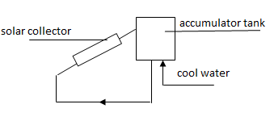
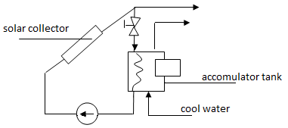
Tutorial 14. ENERGY INVESTMENT OBJECTS
Part 3. Renewable or non-traditional energy sources
INVESTMENT DESIGN INNOVATION IN
THE ENERGY SYSTEM
Passive solar collector without
water intake single-circuit
Solar collector (with forced circulation) with water intake, 2-circuit
Installations with forced circulation of the heat carrier should be used for hot water supply of large objects. The installation with forced circulation of the heat carrier includes a solar energy collector( CSE), a heat accumulator, heat exchangers for transferring heat from the CSE to the battery and from it to consumers , a pump or fan, a backup energy source and a set of devices for automatic control of the system operation.

Slide 7
Tutorial 14. ENERGY INVESTMENT OBJECTS
Part 3. Renewable or non-traditional energy sources
INVESTMENT DESIGN INNOVATION IN
THE ENERGY SYSTEM
There are active and passive solar heat supply systems for buildings. Active solar heating is based on the use of engineering systems, which, like hot water systems, include a circulation circuit of liquid coolant or air. In practice, liquid solar heating systems are more common. However, they require the presence of heating devices and additional measures to protect against freezing and corrosion.
Air circulation in the scheme with air heating is carried out in a closed circuit through a collector and a pebble accumulator.
Passive solar heating systems use south-facing glazed elements of large-area building structures to accumulate and transfer heat to the consumer.

Slide 8
Tutorial 14. ENERGY INVESTMENT OBJECTS
Part 3. Renewable or non-traditional energy sources
INVESTMENT DESIGN INNOVATION IN
THE ENERGY SYSTEM
Installation
Solar water heaters are installed on the roof of buildings at an angle to the horizon equal to the geographical latitude of the area.
In addition, groups of heaters are installed in open spaces, for example, above parking lots for cars, but as close as possible to the consumer (building).
Due to the fact that the solar heater cannot be switched off, during periods of maximum solar exposure and low water intake, the temperature (stagnation temperature or stagnation temperature) in it can reach, depending on the type, 200 °C (flat systems) and 300 °C (vacuum systems).
In this regard, plastic (polymer) pipes and steel pipes with a zinc coating can not be used as a pipe binding of water heaters. Copper or stainless steel pipes should be used.
It is also necessary to provide thermal insulation of the first (hot) circuit of the pipe binding of water heaters to prevent burns and fires, and the material of thermal insulation and fasteners must meet the specified temperature conditions.
The exact stagnation temperature for this model range is indicated on the industrial collector housings.
The service life of the collectors is at least 15 years.
Application
Solar water heaters are used for domestic and commercial hot water supply, industrial heat supply, and water heating for swimming pools.
The largest number of production processes that use warm and hot water (30-90°C) take place in the food and textile industries, which thus have the highest potential for using solar collectors.

Slide 9
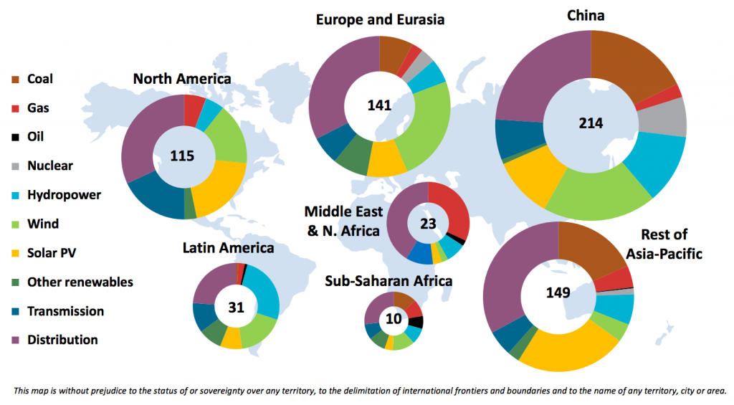
Tutorial 14. ENERGY INVESTMENT OBJECTS
Part 3. Renewable or non-traditional energy sources
INVESTMENT DESIGN INNOVATION IN
THE ENERGY SYSTEM

Slide 10
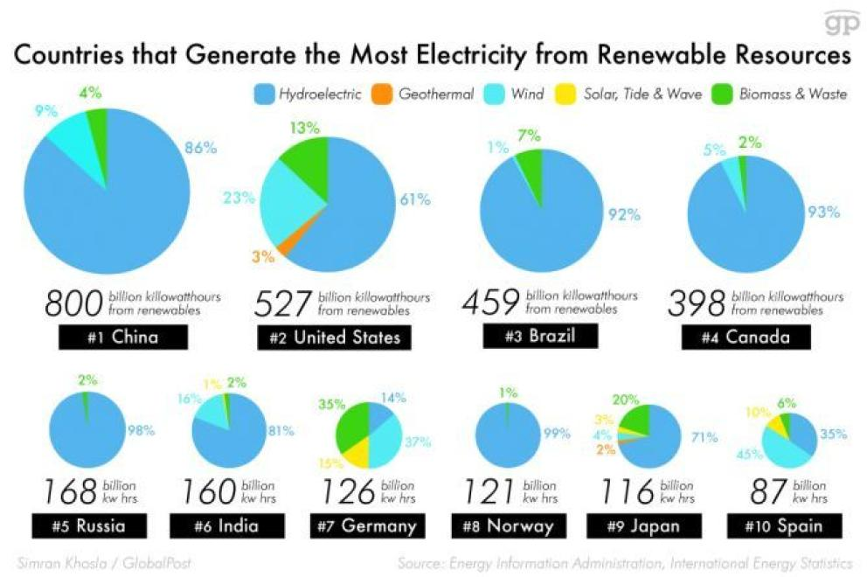
Tutorial 14. ENERGY INVESTMENT OBJECTS
Part 3. Renewable or non-traditional energy sources
INVESTMENT DESIGN INNOVATION IN
THE ENERGY SYSTEM

Slide 11
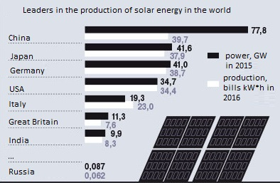
Tutorial 14. ENERGY INVESTMENT OBJECTS
Part 3. Renewable or non-traditional energy sources
INVESTMENT DESIGN INNOVATION IN
THE ENERGY SYSTEM

Slide 12
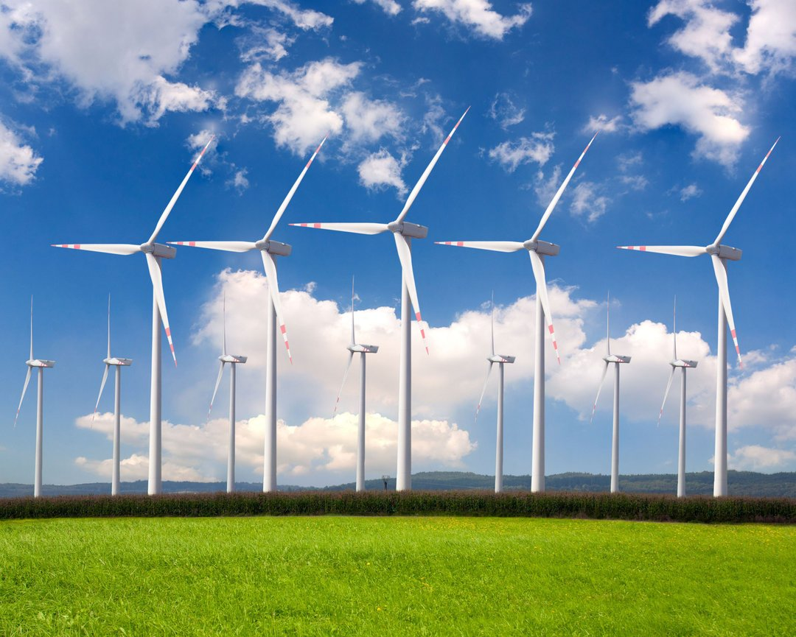
INVESTMENT DESIGN INNOVATION IN THE ENERGY SYSTEM
14.2 Wind energy.
The principle of operation and classification of wind turbines
The wind power plant of the wind turbine is designed to convert the kinetic energy of the wind into the energy of rotation of the rotor of the generator, which generates electricity.
For the effective operation of wind turbines, certain requirements for their placement are necessary. So, for the relatively constant operation of wind turbines, they need to be located in areas where the wind potential is 2500 hours per year . Modern wind turbines use the wind of the surface layer at an altitude of 50-70 m, less often up to 100 m from the Ground surface, and for the construction sites of large wind turbines designed to work in powerful power systems, it is necessary that the average annual wind speed at an altitude of 10 m is at least 6 m/s, for wind turbines with a capacity of up to 5-6 kW, the wind speed should be 3.5-4 m/s.

Slide 13
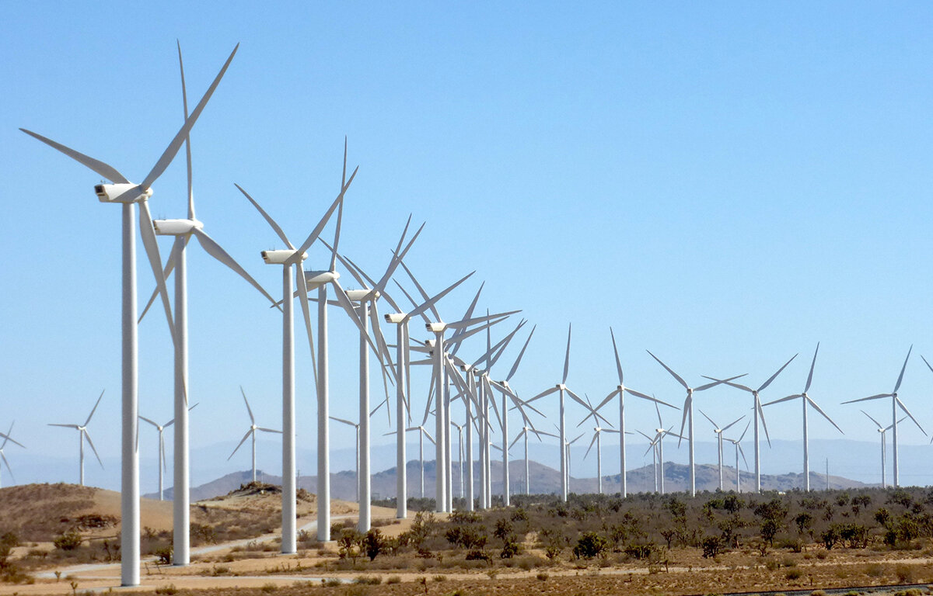
Tutorial 14. ENERGY INVESTMENT OBJECTS
Part 3. Renewable or non-traditional energy sources
INVESTMENT DESIGN INNOVATION IN
THE ENERGY SYSTEM
The main elements of the wind turbine are
- Wind wheel;
- Electric generator;
- System for controlling the parameters of the generated electricity, depending on the change in the wind force and the speed of rotation of the wind wheel.
The introduction of a control system into a wind turbine is associated with the need to meet the requirements for the frequency and voltage of the generated electricity, depending on the characteristics of its consumers.
One of the ways to control the electricity of a wind turbine is to rectify the AC current of the wind turbine and then convert it into AC with the specified stabilized parameters. In periods of calm weather, to avoid interruptions in the power supply, wind turbines must have electric energy accumulators or be connected in parallel with other types of electric power installations.
The principle of operation. The primary working body of the wind turbine, which directly takes on the wind energy and converts it into the energy of its rotation, is the wind wheel. The rotation of the wind wheel under the influence of the wind is due to the fact that it is affected by the resulting force, which can be decomposed into 2 components:
- Power of drag;
- Lifting power.

Slide 14
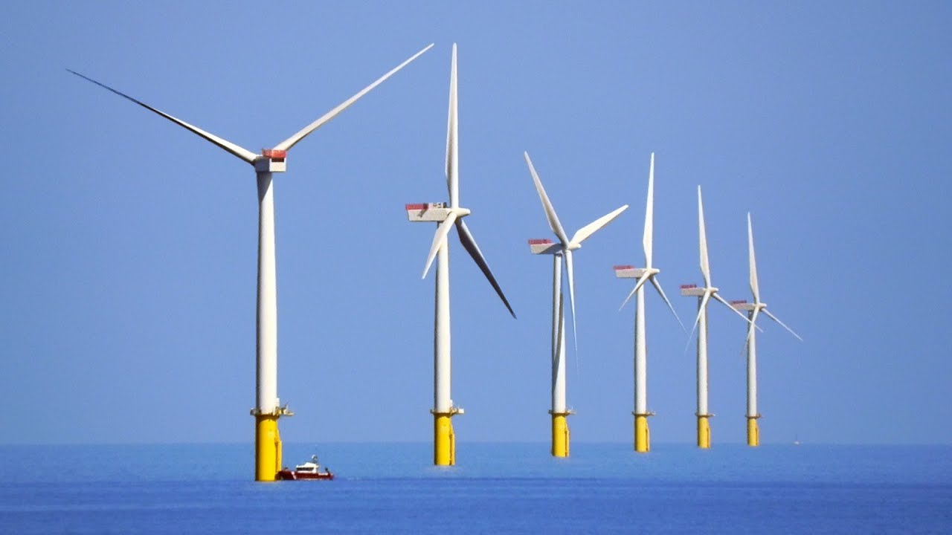
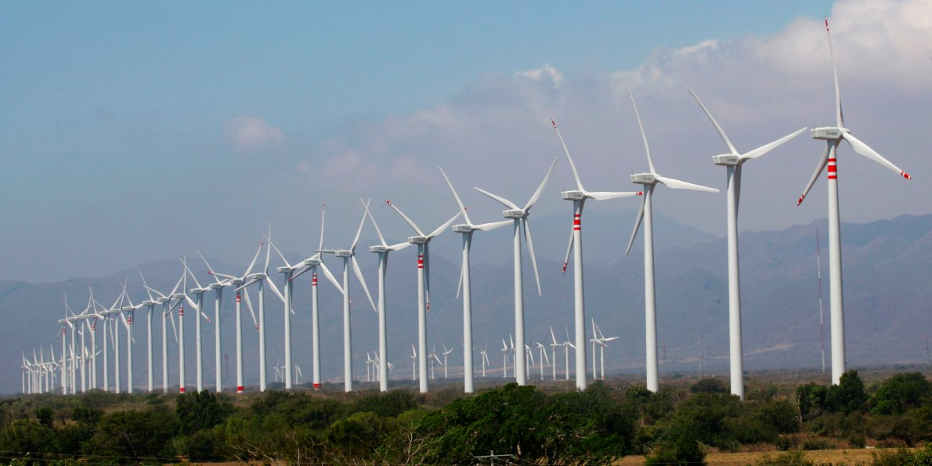
Tutorial 14. ENERGY INVESTMENT OBJECTS
Part 3. Renewable or non-traditional energy sources
INVESTMENT DESIGN INNOVATION IN
THE ENERGY SYSTEM

Slide 15
Tutorial 14. ENERGY INVESTMENT OBJECTS
Part 3. Renewable or non-traditional energy sources
INVESTMENT DESIGN INNOVATION IN
THE ENERGY SYSTEM
Types of wind receiving devices
Several types of wind receiving devices have been developed. Wind-receiving devices have such a configuration, thanks to which asymmetric forces arise in the wind flow and they can rotate, translationally move or vibrate.
Wind turbines can be classified according to the following characteristics:
- the position of the wind wheel relative to the wind direction;
- wheel geometry;
- by the power of the wind turbine.
Depending on the orientation of the axis of rotation in relation to the direction of flow, wind receiving devices are classified as follows:
- With a horizontal axial turbine (wind wheel), when the axis of rotation is parallel to the air flow. These include winged, sailing, Magnus cylinders;
- With a vertical axial turbine when the axis of rotation is perpendicular to the air flow. With the vertical axis of rotation, the track is distinguished. designs of rotors: rotary, rotor Savonius, Darrieus rotor. A wind wheel with a vertical axis of rotation is in the working position in any wind direction, but their disadvantage is a high susceptibility to fatigue damage due to self-oscillating processes and torque pulsation that occur in them, leading to undesirable pulsations of the generator output parameters.

Slide 16
Tutorial 14. ENERGY INVESTMENT OBJECTS
Part 3. Renewable or non-traditional energy sources
INVESTMENT DESIGN INNOVATION IN
THE ENERGY SYSTEM
According to the power of wind turbines are divided into: small power –up to 100 kW; medium-from 100 to 500 kW; large-0.5-4 MW or more.
The most important characteristic of the wind wheel is its speed, which depends on 3 main variables: the radius of the circle swept by the wind wheel, the wind speed, and the angular speed of the wheel.
Horizontal wind turbines with a capacity of up to MW have a high-speed wheel with 2-3 blades, which turns on the tower in the direction of the wind with the help of the orientation control system. Wind turbines with a wheel diameter of 20-40 m and a power of 100-500 kW are mass-produced.
The output power of the installation is proportional to the area of the wind rotor blades and the wind speed. Therefore, high-power wind turbines are large in size, since the wind speed is not very high.
According to the power of wind turbines are divided into: small power –up to 100 kW; medium-from 100 to 500 kW; large-0.5-4 MW or more.
The most important characteristic of the wind wheel is its speed, which depends on 3 main variables: the radius of the circle swept by the wind wheel, the wind speed, and the angular speed of the wheel.

Slide 17
Tutorial 14. ENERGY INVESTMENT OBJECTS
Part 3. Renewable or non-traditional energy sources
INVESTMENT DESIGN INNOVATION IN
THE ENERGY SYSTEM
Horizontal wind turbines with a capacity of up to MW have a high-speed wheel with 2-3 blades, which turns on the tower in the direction of the wind with the help of the orientation control system. Wind turbines with a wheel diameter of 20-40 m and a power of 100-500 kW are mass-produced.
The output power of the installation is proportional to the area of the wind rotor blades and the wind speed. Therefore, high-power wind turbines are large in size, since the wind speed is not very high.
Disadvantages.
1 High material consumption (specific material consumption per kW of energy)
2 Withdrawal of large areas of land resources for the construction of wind turbines. A 1000 MW wind turbine will require an area of 70-200 sq. km.
3 Negative environmental impacts, such as noise, landscape distortion, and interference with radio and television reception.
4. The location of wind parks affects the migration of birds.
5. In the places where wind turbines work, the force of the air flow weakens, and this affects the climate.

Slide 18
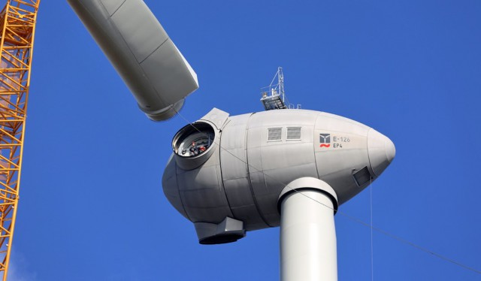
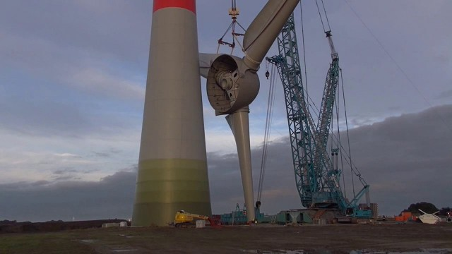
Tutorial 14. ENERGY INVESTMENT OBJECTS
Part 3. Renewable or non-traditional energy sources
INVESTMENT DESIGN INNOVATION IN
THE ENERGY SYSTEM
The biggest wind farm in the world
Enercon E-126 is currently the largest wind turbine in the world. It holds the absolute leadership in the amount of energy produced and is one of the largest in overall dimensions. We can say that this is the brainchild of the German concern Energon (specializing in the production of wind turbines), became the embodiment of a person's dream to make energy, and accordingly money, right out of thin air.

Slide 19
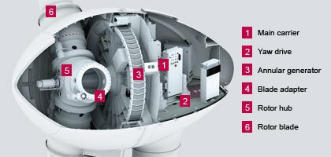
Tutorial 14. ENERGY INVESTMENT OBJECTS
Part 3. Renewable or non-traditional energy sources
INVESTMENT DESIGN INNOVATION IN
THE ENERGY SYSTEM
The Enercon E-126 is the world's largest wind turbine. The height of the tower is 135 meters, the diameter of the rotor is 126 meters, the total height is almost 200 meters. With good winds, it generates up to 7.58 megawatts of electricity
To the tower with rotor firmly stood on the ground, the base is brought to the mass of 2,500 tones (the tower itself weighs 2800 tons, turbine — 128 tons, the generator 220 t, the rotor and blades — 364 tons.), and the whole structure weighs six tons. The first Enercon E-126 wind turbine was installed in 2007 in Germany. One is the construction of a $ 14 million (without installation).

Slide 20
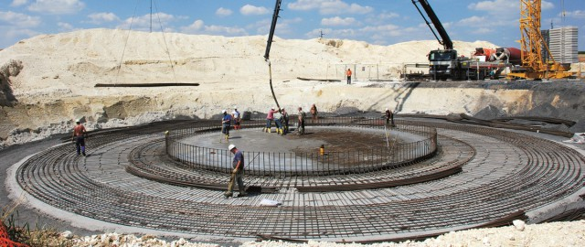
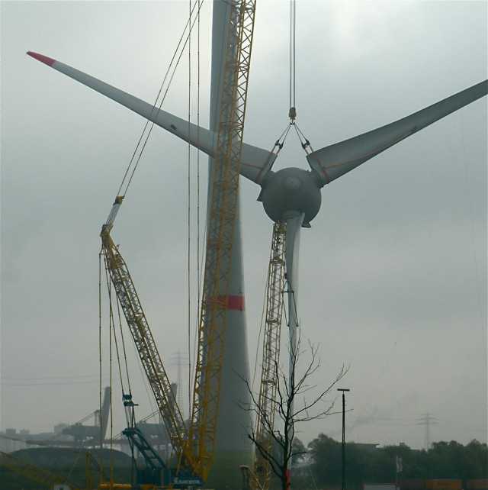
Tutorial 14. ENERGY INVESTMENT OBJECTS
Part 3. Renewable or non-traditional energy sources
INVESTMENT DESIGN INNOVATION IN
THE ENERGY SYSTEM

Slide 21
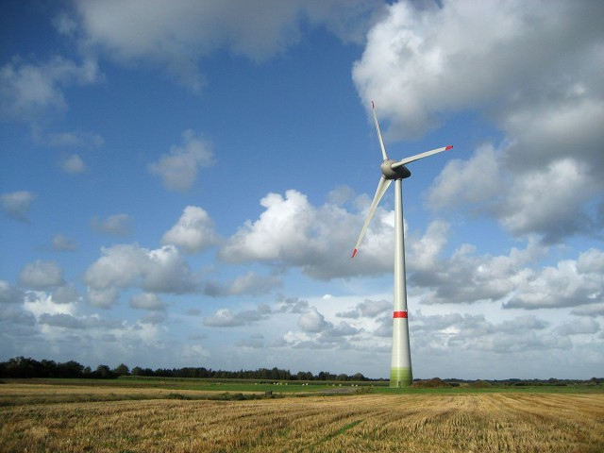
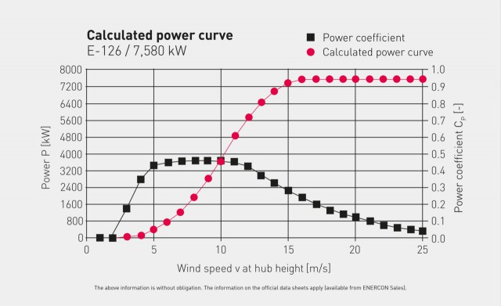
Tutorial 14. ENERGY INVESTMENT OBJECTS
Part 3. Renewable or non-traditional energy sources
INVESTMENT DESIGN INNOVATION IN
THE ENERGY SYSTEM

Slide 22
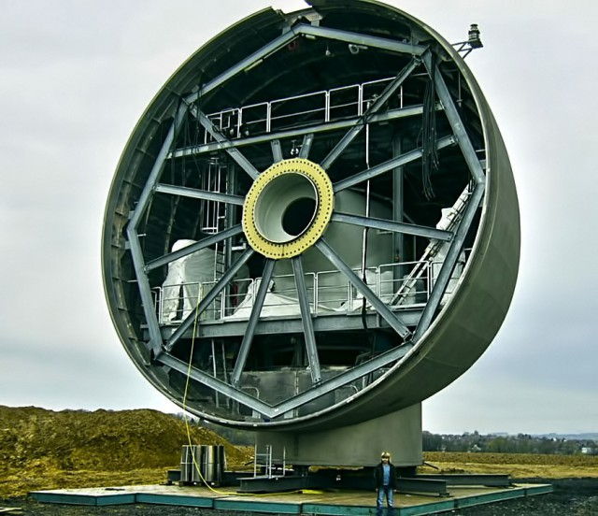
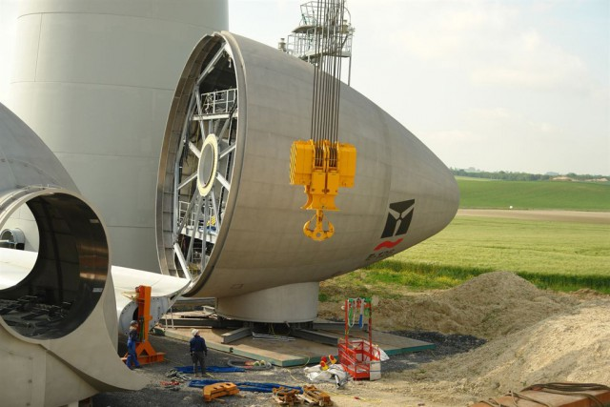
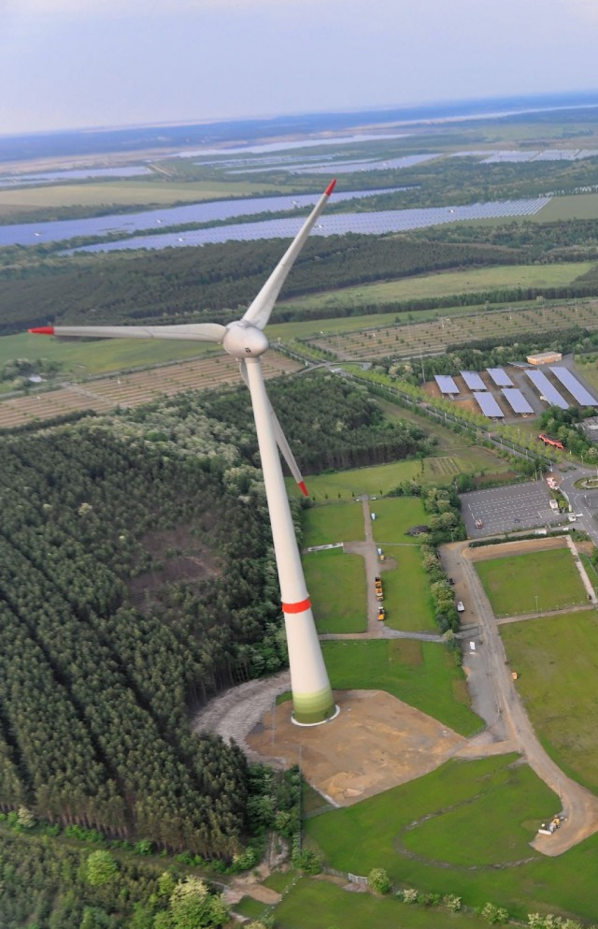
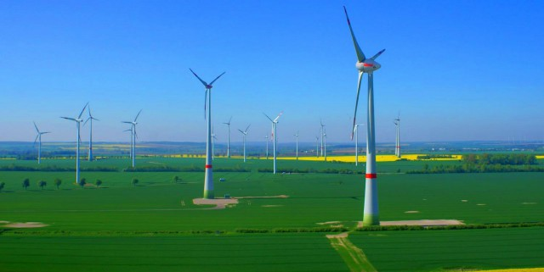
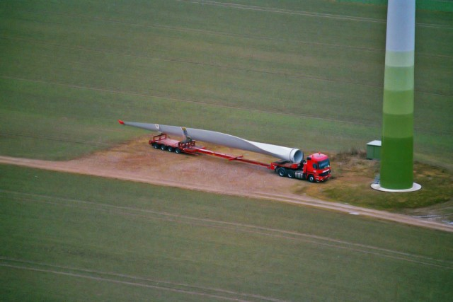
Tutorial 14. ENERGY INVESTMENT OBJECTS
Part 3. Renewable or non-traditional energy sources
INVESTMENT DESIGN INNOVATION IN
THE ENERGY SYSTEM

Slide 23
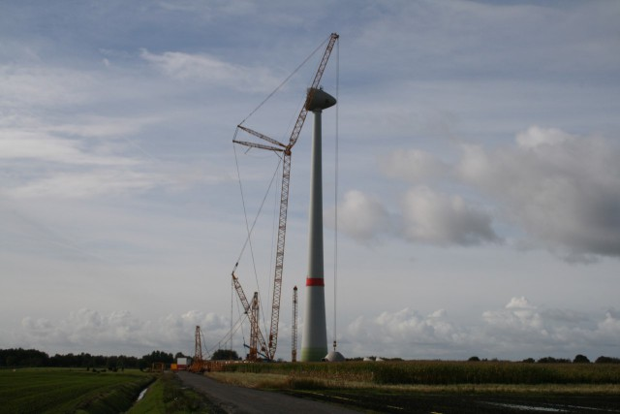
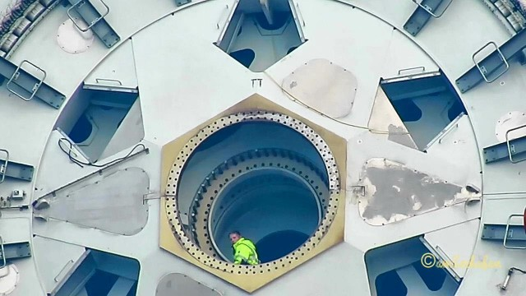
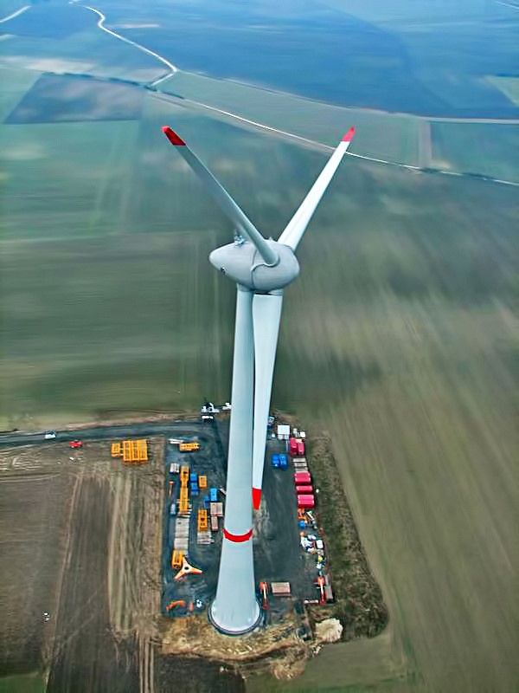
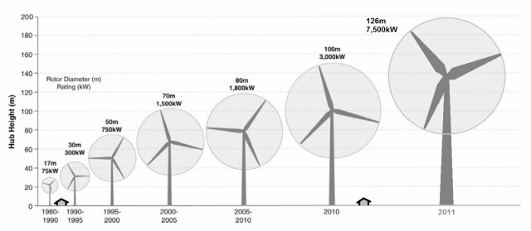
Tutorial 14. ENERGY INVESTMENT OBJECTS
Part 3. Renewable or non-traditional energy sources
INVESTMENT DESIGN INNOVATION IN
THE ENERGY SYSTEM

Slide 24
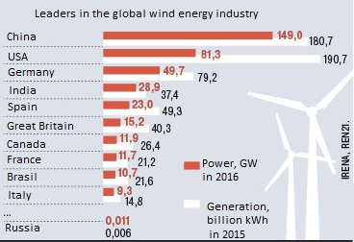
Tutorial 14. ENERGY INVESTMENT OBJECTS
Part 3. Renewable or non-traditional energy sources
INVESTMENT DESIGN INNOVATION IN
THE ENERGY SYSTEM

Slide 25
INVESTMENT DESIGN INNOVATION IN THE ENERGY SYSTEM
14.3 Secondary energy resources in the energy sector.
Any technological process requires a certain consumption of fuel, electrical and thermal energy. As a result of chemical reactions, mechanical influences, heat carriers, gases and liquids with excessive pressure emit heat. Part of the energy that is not directly or indirectly used as useful for the production of finished products or services, naz. energy waste. Total energy waste is equal to the difference between the energy entering the process unit and the energy used usefully.
Energy waste is divided into 3 types:
1. unavoidable losses in the process unit or installation;
2. energy waste of internal use, which is returned back to the technological unit (installation) due to regeneration or recovery, and as a result, the amount of primary energy supplied is reduced;
3. energy waste of external use, which is a secondary energy resource.

Slide 26
Tutorial 14. ENERGY INVESTMENT OBJECTS
Part 3. Renewable or non-traditional energy sources
INVESTMENT DESIGN INNOVATION IN
THE ENERGY SYSTEM
Recuperator – heat exchanger surface type for the use of waste heat, which transfer heat from hot fluid to cold is through the separation wall of the apparatus. Types of recuperators are defined by the scheme of relative movement of heat carriers, the design of heat exchange surfaces, the presence or absence of changes in the aggregate state of heat carriers.
In certain cases, it is possible to use the heat of Secondary energy resources by directly returning part of them to the installation.
The heat returned to the unit can be used for heating:
- Liquid or gaseous fuel;
- Air used for combustion as an oxidizer
- Water directed to the boiler plant,
- Household needs.
The use of Secondary energy resources allows to reduce the consumption of fuel and energy resources, to increase the station's efficiency, reduce specific (energy kW Gcal per unit TER 1m3 of gas), to reduce the share of fuel (energy) component in the cost of production, reduce emissions, and so the impact on the environment.

Slide 27
Tutorial 14. ENERGY INVESTMENT OBJECTS
Part 3. Renewable or non-traditional energy sources
INVESTMENT DESIGN INNOVATION IN
THE ENERGY SYSTEM
Utilization of secondary energy resources is associated with certain costs, including capital, for use in the main cycle of energy production.
There are fuel (fuel) secondary energy resources, thermal secondary energy resources, secondary energy resources of overpressure and combined secondary energy resources.
The energy system contains thermal Secondary energy resources. Thermal secondary energy resources are the physical heat of the exhaust gases of boiler plants, the heat of steam condensate and hot water used in technological and energy units.
Thermal secondary energy resources can come in the form of concentrated heat flows or in the form of heat dissipated into the environment.
Thermal secondary energy resources are divided into high-temperature (with temp. medium-temperature (from 150 to 500 °C) and low-temperature (at a rate below 150 °C), which are found in the power system.

Slide 28
Tutorial 14. ENERGY INVESTMENT OBJECTS
Part 3. Renewable or non-traditional energy sources
INVESTMENT DESIGN INNOVATION IN
THE ENERGY SYSTEM
Secondary energy resources of power plants. Secondary energy resources are also available in thermal and hydroelectric power plants and represent heat waste or heat loss generated in the process of energy production. In hydroelectric power plants, waste heat is generated as a result of heat generation in an electric generator. For thermal power plants, the most significant source of secondary energy resources is the low-potential heat of the heated cooling water of condensing devices, from which up to 50% of the heat of the fuel consumed at the power plant can be lost. The source of secondary energy resources is considered to be the flue gases of boiler installations at steam turbine stations or the waste products of combustion of gas turbine installations.
The source of secondary energy resources can be heated cooling water from the cooling system of power plant generators.
Significant thermal waste is available at nuclear power plants. This is the heat of condensate, the heat of cooling systems, etc.
Heat exchangers, heat recovery boilers and heat pumps are used for the utilization of thermal secondary energy resources
Consider some methods and devices for the utilization of thermal secondary energy resources. One of the options for recycling thermal secondary energy resources for internal use is to use the heat of the exhaust gases of the steam boiler to heat the feed water in the economizer and the air oxidizer in the air heater.

Slide 29
Tutorial 14. ENERGY INVESTMENT OBJECTS
Part 3. Renewable or non-traditional energy sources
INVESTMENT DESIGN INNOVATION IN
THE ENERGY SYSTEM
When used externally, the heat carrier or raw material is heated. The heating of the working medium is carried out in recuperative devices-heat exchangers, separator drums or condensers.
Recuperative heaters are made of metal. The transfer from the cooled to the heated heat carrier occurs constantly by the action of heat carriers on different surfaces of the same wall of the device. Their advantage lies in the constant parameters of working environments, which ensures the stability of technological processes.
Steam or hot water boilers are used as waste flue gas disposal units. Heat recovery boilers provide greater fuel savings by generating energy or process steam, as well as heating water through the use of secondary heat. Unlike power boilers, their heating surfaces are located not in the furnace, but along the exhaust gas path. The design of the heat recovery boiler includes: an economizer, a separator drum, an evaporator and a superheater. A characteristic distinguishing feature of the heat recovery boiler is the lack of a furnace device for burning fuel. Water circulation through the evaporator is carried out by means of a pump or by natural convection. The principle of operation of heat recovery boilers is identical to the boilers of boiler plants.
The potential of combustible secondary energy resources is characterized by the lowest heat of combustion Q, thermal secondary energy resources-the difference in enthalpy Δh, excess pressure-the work of isentropic expansion L.

Slide 30

Tutorial 14. ENERGY INVESTMENT OBJECTS
Part 3. Renewable or non-traditional energy sources
INVESTMENT DESIGN INNOVATION IN
THE ENERGY SYSTEM
Test
Advantages and disadvantages of using renewable energy sources
Tower-type solar power plants.
Solar power plants of the distribution type
Direct conversion of solar energy into electrical energy. Solar panels.
Solar hot water and heat supply system for buildings
Wind energy.
Secondary energy sources

